Slide 1
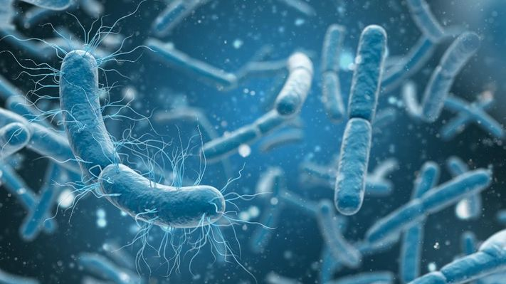
Bacteria (Part II)
Presented by:
Dr. Ankit Kumar Singh
Assistant Professor
Department of Botany
Marwari College
Lalit Narayan Mithila University
Darbhanga
ankitbhu30@gmail.com

Slide 2
Classification of Bacteria on the basis of shape
Bacteria have variation in their shape. On the basis of their shape bacteria are of different types.
1. Coccus
These bacteria are spherical in shape
These are smallest bacteria
These are highly resistant bacteria
Coccus are following types
Monococcus
These spherical bacteria live alone (single sphere)
e.g. Micrococcus, Dialister pneumosintes
Diplococcus
These are found in pair.
e.g. Diplococcus pneumniae, Neisseria

Slide 3
Tetracoccus
These are found in group of four cocci.
e.g. Micrococcus luteus
Streptococcus
These are found in form of chain
e.g. Streptococcus lactis
Sarcinae
8 to 64 or more bacteria are found in cubical mass form
e.g. Sarcina
Staphylococcus
These bacteria are found in a irregular bunch
e.g. Staphylococcus alvus

Slide 4
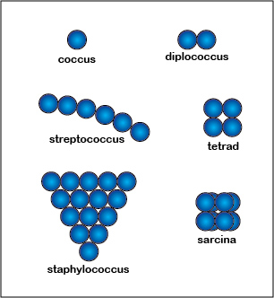

Slide 5
2. Bacillus
This group includes most of the bacteria.
These are rod shaped
Bacillus are following types
Single bacillus
Only one rod -like structure or bacterium.
e.g. E.coli, Lactobacillus
Diplobacillus
They are found in pairs
e.g. Diplobacillus
Streptobacillus
They are found in a chain
e.g. Bacillus anthracis, Bacillus subtilis
Palisade bacillus –
These rod shaped bacteria are found in form of stacks
e.g. Corynebacterium diphtheriae

Slide 6
3. Spirillum
These are spiral shaped bacteria
e.g. Spirillum volutans, Spirochete, Helibacter, Treponema
4. Comma (Vibrio)
These are comma shaped bacteria
e.g. Vibrio cholerae, Vibrio comma
5. Stalked bacteria
These are single celled bzteria with narrow stalked
e.g. Caulobacter
6. Budding bacteria
They appear like a beaded cell
e.g. Rhodomicrobium
7. Pleomorphic bacteria
These bacteria change their shape according to medium
e.g. Rhizobium

Slide 7
Economic Importance
Beneficial aspects of bacteria
Role of bacteria in soil fertility
Ammonification- Ammonifying bacteria
Some bacteria convert protein (present in decaying plants & animals) into ammonia
e.g. Bacillus vulgaris, Bacillus ramosus
Nitrification- Nitrifying bacteria
These bacteria convert ammonia into nitrite and later into nitrate
Nitrogen fixation- Nitrogen fixing bacteria
These bacteria convert the atmospheric nitrogen into amino acids, nitrate or ammonium salts. Nitrogen fixation is done by two methods-
(A) Symbiotically
e.g. Rhizobium, Azospirillum, Frankia
(B) Asymbiotically
e.g. Clostridium, Chromatium, Azotobacter, Rhodospirillum

Slide 8
2. Dairy products
Curd
e.g. Lactobacillus lactis
Butter
e.g. Streptococcus lactis
Yoghurt
e.g. Lactobacillus bulgaricus
3. Antibiotics
Bacitracin : Bacillus lincheniformis
Polymyxin : Bacillus polymyxa
Gramicidin : Bacillus brevis
Subtilin & Bacitracin : Bacillus subtilis
Streptomycin : Streptomyces griseus
Tarramycin: Streptomyces rimosus
Neomycin : Streptomyces fradiae

Slide 9
3. Industries
Alcohol formation
e.g. Sarcina veutriculi
Vinegar formation
e.g. Acetobacter aceti
Retting of fibres
e.g. Clostridium
Flavouring of tobacco & tea leaves
e.g. Bacillus megatherium, Micrococcus condiscence
4. Bacteria for specific pests
e.g. Bacillus popilliae : Japaneese Beetle
Bacillus spharicus : Anopheles
5. Bacteria for genetic engineering
e.g. E.coli and Agrobacterium sp.
6. Oil clearing bacteria
e.g. Pseudomonas putida

Slide 10
Genetically engineered E. coli
Used for the production of human insulin .e.g. ‘Humulin’ to treat diabetes and human growth hormone Somatotropin to treat dwarfism ; production of biofuels e.g. Bioethanol.
Genetically engineered bacterium for the production of vitamins – e.g. Propionibacterium freudenreichii for the production of vitamin B12.
Genetically engineered Pseudomonas putida – super bug – for cleaning oil spills.
Deinococcus radiodurans is another genetically engineered bacterium, which can be used as a bioremediator to degrade toluene and mercury from highly radioactive nuclear wastes.
Bt gene (cry gene ) from the bacterium Bacillus thuringiensis is transferred to crop plants by recombinant DNA technology to form Bt crops - e.g. Bt cotton, Bt corn, Bt brinjal etc. which are resistant to insects of specific groups like Lepidoptera ( Butterfly, Moth etc. ) and Diptera ( Mosquitoes, House fly etc.).

Slide 11
Bacteria as Single Cell Protein (SCP)
Pruteen, produced from bacteria, Methylophilus methylotrophus, cultured on Methanol had 72% protein content, was the first commercial SCP used as animal feed supplement.
Species of bacteria like Cellulomonas, Alcaligenes etc. are also used for the production of single cell protein.

Slide 12
Harmful aspects of bacteria
1. Disease in human beings
Tuberculosis (T.B.) – Mycobacterium tuberculosis
Diphtheria – Corynebacterium diphetheriae
Tetanus – Clostridium tetani
Typhoid – Salmonella typhi
Plague – Pasteurella pestis
Pneuminia – Diplococcus pneumoniae
Jaundice – Leptospira ictero
Cholera – Vibrio cholerae
Meningitis – Neisseria meningitidis
2. Disease in animals
Anthrax – Bacillus anthracis
Black leg – Clostridium chanvei

Slide 13
3. Disease in plants
Citrus canker – Xnthomonas citri
Leaf blight of rice – Xanthomonas oryzae
Leaf streak of rice – Xanthomonas oryzicola
Crown gall in many plants – Agrobacterium tumefaciens
Brown rot or wilt of potatoes – Pseudomonas solanacearum
4. Food poisoning
e.g. Salmonella enteridid
Staphylococcus oaureus
Clostridium botulinum (Botulism)
5. Water pollution
e.g. Vibrio cholerae
Salmonella typhi
Shigella dysenteriae
6. Biological weapons

Slide 14
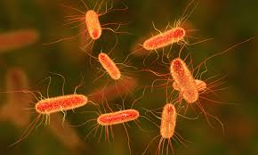
Thank You !!

